Slide 1
Module3_CPU_Scheduling
Reference: “OPERATING SYSTEM CONCEPTS”, ABRAHAM SILBERSCHATZ, PETER BAER GALVIN, GREG GAGNE , Wiley publications.

Slide 2
Objectives
To introduce CPU scheduling, which is the basis for multiprogrammed operating systems
To describe various CPU-scheduling algorithms
To discuss evaluation criteria for selecting a CPU-scheduling algorithm for a particular system

Slide 3
Basic Concepts
Maximum CPU utilization is obtained with multiprogramming
CPU–I/O Burst Cycle – Process execution consists of a cycle of CPU execution and I/O wait
CPU burst followed by I/O burst
CPU burst distribution is of main concern
CPU Burst Time: The amount of time a process executes before it goes to wait state

Slide 4
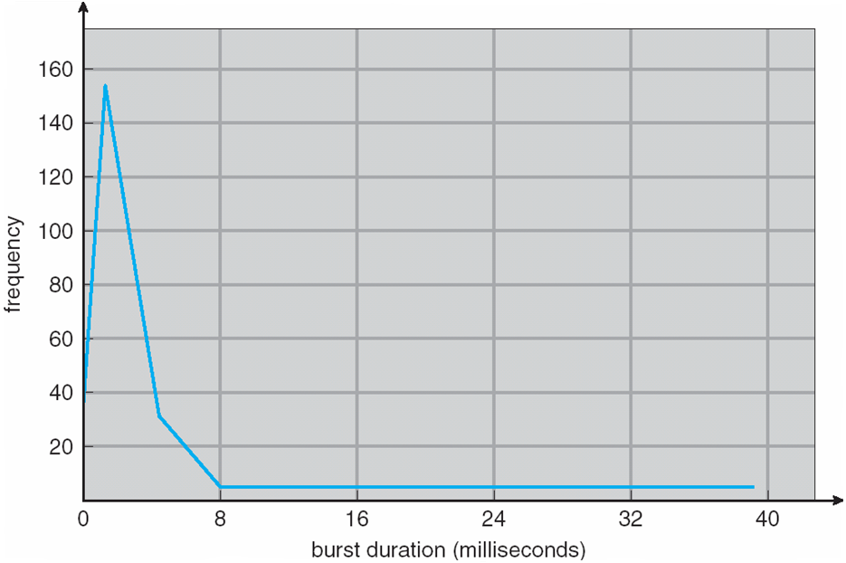
Histogram of CPU-burst Times

Slide 5
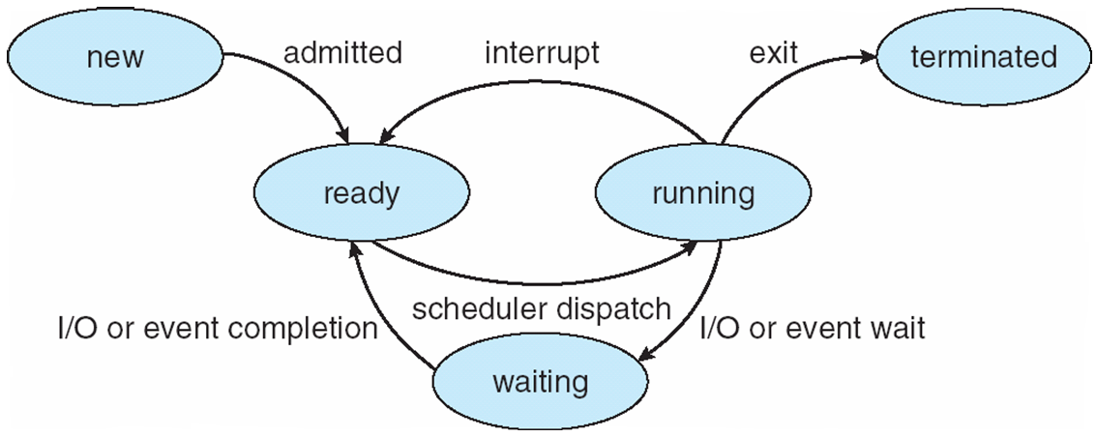
CPU Scheduler
Short-term scheduler selects from among the processes in ready queue, and allocates the CPU to one of them
Queue may be ordered in various ways
CPU scheduling decisions may take place when a process:
1. Switches from running to waiting state
2. Switches from running to ready state
3. Switches from waiting to ready
Terminates
Scheduling under 1 and 4 is nonpreemptive
All other scheduling is preemptive
Consider access to shared data
Consider preemption while in kernel mode
Consider interrupts occurring during crucial OS activities

Slide 6
Dispatcher
Dispatcher module gives control of the CPU to the process selected by the short-term scheduler; this involves:
switching context
switching to user mode
jumping to the proper location in the user program to restart that program
Dispatch latency – time taken by the the dispatcher to stop one process and start another running

Slide 7
Scheduling Criteria
CPU utilization – keep the CPU as busy as possible
Throughput – # of processes that complete their execution per time unit
Turnaround time – amount of time to execute a particular process
Waiting time – amount of time a process has been waiting in the ready queue
Response time – amount of time taken from when a request was submitted until the first response is produced, not output (for time-sharing environment)

Slide 8
Scheduling Algorithm Optimization Criteria
Maximize CPU utilization
Maximize throughput
Minimize turnaround time
Minimize waiting time
Minimize response time
uptime -> Linux command
system calls
time
sched_getscheduler()
sched_setscheduler()

Slide 9
First- Come, First-Served (FCFS) Scheduling
Example 1: Consider the following processes with their burst time. Use FCFS to schedule the processes and compute the average waiting time.
Process ID Burst Time
P₁ 24
P₂ 3
P₃ 3
Suppose that the processes arrive in the order: P₁ , P₂ , P₃ The Gantt Chart for the schedule is:
Waiting time for P₁ = 0; P₂ = 24; P₃ = 27
Average waiting time: (0 + 24 + 27)/3 = 17

Slide 10
First- Come, First-Served (FCFS) Scheduling
Example 1: Continued
The Gantt Chart for the schedule is:
Waiting time for P₁ = 0; P₂ = 24; P₃ = 27
Average waiting time: (0 + 24 + 27)/3 = 17
Process ID | Burst Time | Completion Time | TurnAround Time | Wait Time
P1 | 24 | 24 | 24 | 0
P2 | 3 | 27 | 27 | 24
P3 | 3 | 30 | 30 | 27
Turnaround Time = Completion Time - Arrival Time
Waiting Time = Turn Around Time - Burst Time

Slide 11
FCFS Scheduling (Cont.)
Example 1: Continued
Suppose that the processes arrive in the order: P₂ , P₃ , P₁
Process ID Burst Time
P₁ 24
P₂ 3
P₃ 3
The Gantt chart for the schedule is:
Waiting time for P₁ = 6; P₂ = 0; P₃ = 3
Average waiting time: (6 + 0 + 3)/3 = 3
Much better than previous case
Performance of FCFS is dynamic
Convoy effect - short process behind long process
- Consider one CPU-bound and many I/O-bound processes

Slide 12
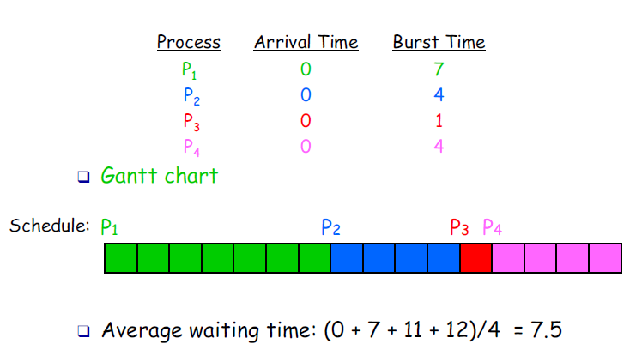
First- Come, First-Served (FCFS) Scheduling
Example 2

Slide 13
First- Come, First-Served (FCFS) Scheduling
Example 2: Continued
The Gantt Chart for the schedule is:
Average waiting time: (0 +7+11+12)/4 = 7.5
Process ID | Burst Time | Completion Time | TurnAround Time | Wait Time
P1 | 7 | 7 | 7 | 0
P2 | 4 | 11 | 11 | 7
P3 | 1 | 12 | 12 | 11
P4 | 4 | 16 | 16 | 12

Slide 14
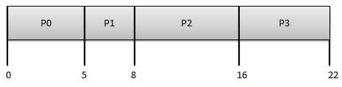
First- Come, First-Served (FCFS) Scheduling
Example 3: Consider the following processes with their burst time and arrival time. Use FCFS to schedule the processes and compute the average waiting time.
The Gantt Chart for the schedule is:
Average Waiting Time: (0+4+6+13) / 4 = 5.75
Process ID | BurstTime | ArrivalTime
P0 | 5 | 0
P1 | 3 | 1
P2 | 8 | 2
P3 | 6 | 3

Slide 15
First- Come, First-Served (FCFS) Scheduling
Example 3 (cont’d):
The Gantt Chart for the schedule is:
Average Waiting Time: (0+4+6+13) / 4 = 5.75
Process ID | Burst Time | Arrival Time | Completion Time | TurnAround Time | Wait Time
P0 | 5 | 0 | 5 | 5 | 0
P1 | 3 | 1 | 8 | 7 | 4
P2 | 8 | 2 | 16 | 14 | 6
P3 | 6 | 3 | 22 | 19 | 13

Slide 16

First- Come, First-Served (FCFS) Scheduling
Example 4: Consider the following processes with their burst time and arrival time. Use FCFS to schedule the processes and compute the average waiting time.
The Gantt Chart for the schedule is:
Average waiting time = (0 + 6 + 3 + 7)/4 = 4
Process ID | Burst Time | Arrival Time
P1 | 7 | 0
P2 | 4 | 2
P3 | 1 | 4
P4 | 4 | 5

Slide 17
First- Come, First-Served (FCFS) Scheduling
Example 4: (continued)
The Gantt Chart for the schedule is:
Average waiting time = (0 + 5 + 7 + 7)/4 = 4.75
Process ID | Burst Time | Arrival Time | Completion Time | TurnAround Time | Wait Time
P1 | 7 | 0 | 7 | 7 | 0
P2 | 4 | 2 | 11 | 9 | 5
P3 | 1 | 4 | 12 | 8 | 7
P4 | 4 | 5 | 16 | 11 | 7

Slide 18
Shortest-Job-First (SJF) Scheduling
Associate with each process the length of its next CPU burst
Use these lengths to schedule the process with the shortest time
SJF is optimal – gives minimum average waiting time for a given set of processes
The difficulty is knowing the length of the next CPU request
Could ask the user

Slide 19
SJF – Example 1
Example 1: Consider the following processes with their burst time. Use SJF to schedule the processes and compute the average waiting time.
SJF scheduling chart
Average waiting time = (3 + 16 + 9 + 0) / 4 = 7
Process ID | Burst Time
P1 | 6
P2 | 8
P3 | 7
P4 | 3

Slide 20
SJF – Example 1 (cont’d)
Scheduling Table
SJF scheduling chart
Average waiting time = (3 + 16 + 9 + 0) / 4 = 7
Process ID | Burst Time | Completion Time | TurnAround Time | Wait Time
P1 | 6 | 9 | 9 | 3
P2 | 8 | 24 | 24 | 16
P3 | 7 | 16 | 16 | 9
P4 | 3 | 3 | 3 | 0

Slide 21
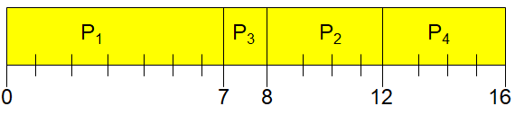
SJF Scheduling - Example
Example 2: Consider the following processes with their burst time and arrival time. Use SJF to schedule the processes and compute the average waiting time.
The Gantt Chart for the schedule is:
Average waiting time = (0 + 6 + 3 + 7)/4 = 4
Process ID | Burst Time | Arrival Time
P1 | 7 | 0
P2 | 4 | 2
P3 | 1 | 4
P4 | 4 | 5

Slide 22
SJF Scheduling - Example
Example 2: (continued)
The Gantt Chart for the schedule is:
Average waiting time = (0 + 6 + 3 + 7)/4 = 4
Process ID | Burst Time | Arrival Time | Completion Time | TurnAround Time | Wait Time
P1 | 7 | 0 | 7 | 7 | 0
P2 | 4 | 2 | 12 | 10 | 6
P3 | 1 | 4 | 8 | 4 | 3
P4 | 4 | 5 | 16 | 11 | 7

Slide 23
Determining Length of Next CPU Burst
Can only estimate the length – should be similar to the previous one
Then pick process with shortest predicted next CPU burst
Can be done by using the length of previous CPU bursts, using exponential averaging
Commonly, α set to ½
Preemptive version of SJF is called Shortest-Remaining-Time-First (SRTF)

Slide 24
Prediction of the Length of the Next CPU Burst

Slide 25
Examples of Exponential Averaging
α =0
τ_{n+1} = τ_{n}
Recent history does not count
α =1
τ_{n+1} = α t_{n}
Only the actual last CPU burst counts
If we expand the formula, we get:
τ_{n+1} = α t_{n}+(1 - α)α t_{n} ₋₁ + …
+(1 - α )^{j} α t_{n} _{-j} + …
+(1 - α )^{n +1} τ₀
Since both α and (1 - α) are less than or equal to 1, each successive term has less weight than its predecessor

Slide 26
Example of Shortest-remaining-time-first
Preemptive version of SJF is called Shortest-Remaining-Time-First (SRTF)
Now we add the concepts of varying arrival times and preemption to the analysis
ProcessaArrival TimeT Burst Time Completion Time Wait Time
P₁ 0 8 17 9
P₂ 1 4 5 0
P₃ 2 9 26 15
P₄ 3 5 10 2
Preemptive SJF Gantt Chart
Average waiting time = [(10-1)+(1-1)+(17-2)+5-3)]/4 = 26/4 = 6.5 msec

Slide 27
Example of Preemptive SJF
Process Arrival Time Burst Time
P₁ 0 7
P₂ 2 4
P₃ 4 1
P₄ 5 4
SJF (preemptive)
Average waiting time = (9 + 1 + 0 +2)/4 = 3
P₁
P₂
P₃
P₂
P₄
P₁
0
2
4
5
7
11
16

Slide 28
Example of Preemptive SJF
Example:
Process ID | Burst Time | Arrival Time
P1 | 7 | 0
P2 | 4 | 2
P3 | 1 | 4
P4 | 4 | 5
Process ID | Burst Time | Arrival Time | Turn Around Time | Wait Time
P1 | 7 | 0 | 16 | 9
P2 | 4 | 2 | 5 | 1
P3 | 1 | 4 | 1 | 0
P4 | 4 | 5 | 6 | 2

Slide 29
Priority Scheduling
A priority number (integer) is associated with each process
The CPU is allocated to the process with the highest priority (smallest integer ≡ highest priority)
Preemptive
Nonpreemptive
SJF is priority scheduling where priority is the inverse of predicted next CPU burst time
Problem ≡ Starvation – low priority processes may never execute
Solution ≡ Aging – as time progresses increase the priority of the process

Slide 30
Priority Scheduling - Example
Example 1: Consider the following processes with their burst time and priority. Use priority to schedule the processes and compute the average waiting time.
Process ID | Burst Time | Priority
P1 | 10 | 3
P2 | 1 | 1
P3 | 2 | 4
P4 | 1 | 5
P5 | 5 | 2

Slide 31
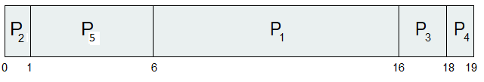
Priority Scheduling - Example
Example 1 (cont’d) :
Priority scheduling Gantt Chart:
Average waiting time = (6+0+16+18+1)/5 = 8.2 msec
Process ID | Burst Time | Priority | TurnAround Time | Wait Time
P1 | 10 | 3 | 16 | 6
P2 | 1 | 1 | 1 | 0
P3 | 2 | 4 | 18 | 16
P4 | 1 | 5 | 19 | 18
P5 | 5 | 2 | 6 | 1

Slide 32
Priority Scheduling - Example
Example 2: Consider the following processes with their burst time and priority. Use priority to schedule the processes and compute the average waiting time.
Process ID | Priority | Arrival Time | Burst Time
1 | 2 | 0 | 1
2 | 6 | 1 | 7
3 | 3 | 2 | 3
4 | 5 | 3 | 6
5 | 4 | 4 | 5
6 | 10 | 5 | 15
7 | 9 | 6 | 8

Slide 33
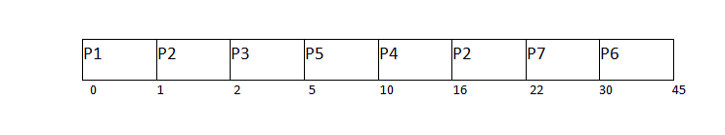
Priority Scheduling - Example
Example 2 (continued): Gantt Chart
Average Waiting Time = (0+14+0+7+1+25+16)/7 = 63/7 = 9 units
Process ID | Priority | Arrival Time | Burst Time | Completion Time | Turn Around Time | Wait Time
1 | 2 | 0 | 1 | 1 | 1 | 0
2 | 6 | 1 | 7 | 22 | 21 | 14
3 | 3 | 2 | 3 | 5 | 3 | 0
4 | 5 | 3 | 6 | 16 | 13 | 7
5 | 4 | 4 | 5 | 10 | 6 | 1
6 | 10 | 5 | 15 | 45 | 40 | 25
7 | 9 | 6 | 8 | 30 | 24 | 16

Slide 34
Round Robin (RR)
Each process gets a small unit of CPU time (time quantum q), usually 10-100 milliseconds.
After this time has elapsed, the process is preempted and added to the end of the ready queue.
If there are n processes in the ready queue and the time quantum is q, then each process gets 1/n of the CPU time in chunks of at most q time units at once.
No process waits more than (n-1)q time units.
Timer interrupts every quantum to schedule next process
Performance
q large ⇒ FIFO
q small ⇒ q must be large with respect to context switch, otherwise overhead is too high

Slide 35
Example of RR with Time Quantum = 4
Process Burst Time
P₁ 24
P₂ 3
P₃ 3
The Gantt chart is:
Typically, higher average turnaround than SJF, but better response
q should be large compared to context switch time
q usually 10ms to 100ms, context switch < 10 usec

Slide 36
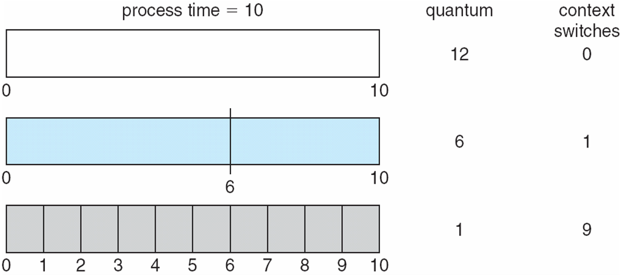
Time Quantum and Context Switch Time

Slide 37
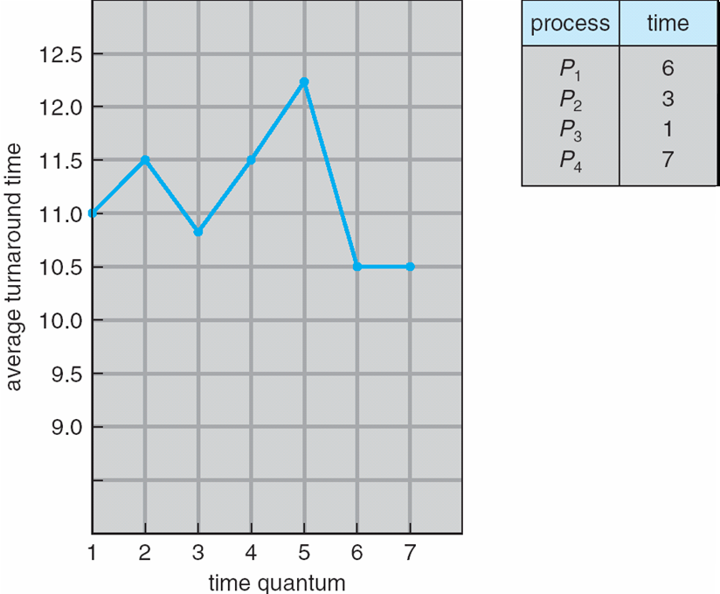
Turnaround Time Varies With The Time Quantum
80% of CPU bursts should be shorter than q

Slide 38
Multilevel Queue
Ready queue is partitioned into separate queues, eg:
foreground (interactive)
background (batch)
Process is permanently in a given queue
Each queue has its own scheduling algorithm:
foreground – RR
background – FCFS
Scheduling must be done between the queues:
Fixed priority scheduling; (i.e., serve all from foreground then from background). Possibility of starvation.
Time slice – each queue gets a certain amount of CPU time which it can schedule amongst its processes; i.e., 80% to foreground in RR
20% to background in FCFS

Slide 39
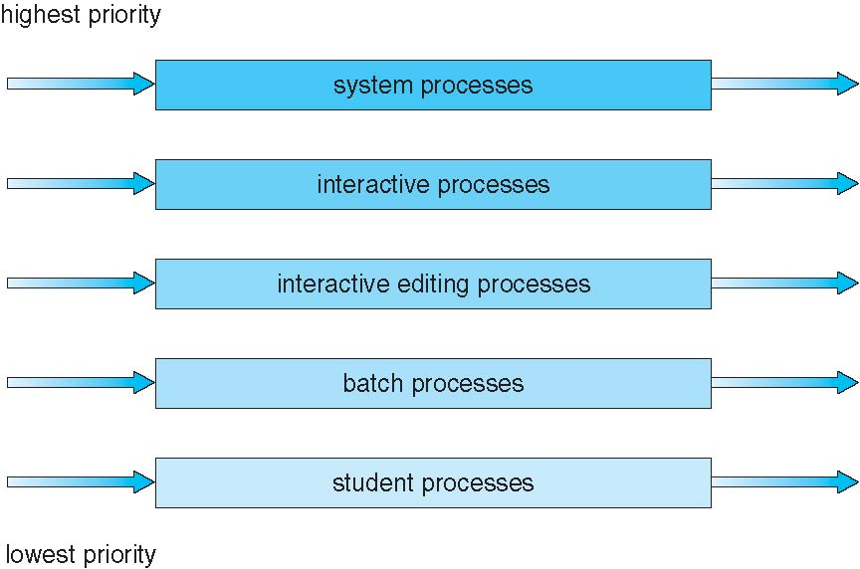
Multilevel Queue Scheduling

Slide 40
Multilevel Feedback Queue
A process can move between the various queues; aging can be implemented this way
Multilevel-feedback-queue scheduler is defined by the following parameters:
number of queues
scheduling algorithms for each queue
method used to determine when to upgrade a process
method used to determine when to demote a process
method used to determine which queue a process will enter when that process needs service

Slide 41
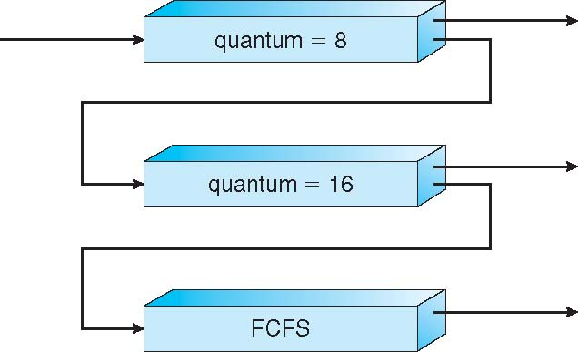
Example of Multilevel Feedback Queue
Three queues:
Q₀ – RR with time quantum 8 milliseconds
Q₁ – RR time quantum 16 milliseconds
Q₂ – FCFS
Scheduling
A new job enters queue Q₀ which is served by FCFS
When it gains CPU, job receives 8 milliseconds
If it does not finish in 8 milliseconds, job is moved to queue Q₁
At Q₁ job is again served by FCFS and receives 16 additional milliseconds
If it still does not complete, it is preempted and moved to queue Q₂

Slide 42
References
For more practice problems
https://www.gatevidyalay.com/round-robin-round-robin-scheduling-examples/

